Slide 1
CS 544 Final Project
--
World Happiness Report 2021
Yung-Chieh Yang

Slide 2
Data set Overview
The World Happiness Report is a landmark survey of the state of global happiness.
The happiness scores and rankings use data from the Gallup World Poll . The columns following the happiness score estimate the extent to which each of six factors – economic production, social support, life expectancy, freedom, absence of corruption, and generosity.

Slide 3
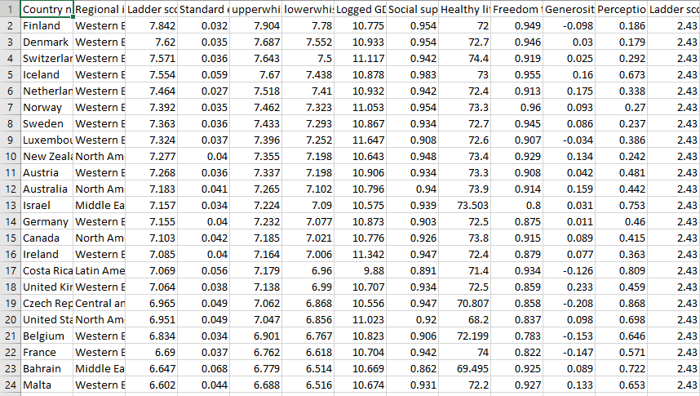

Slide 4

#1 How many countries are in this data set?
149 Countries

Slide 5
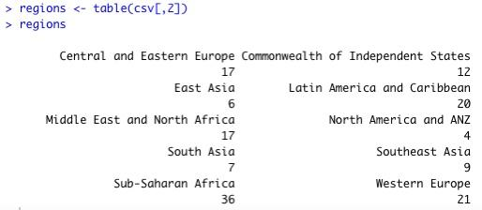
#2 Categorical data by country region

Slide 6
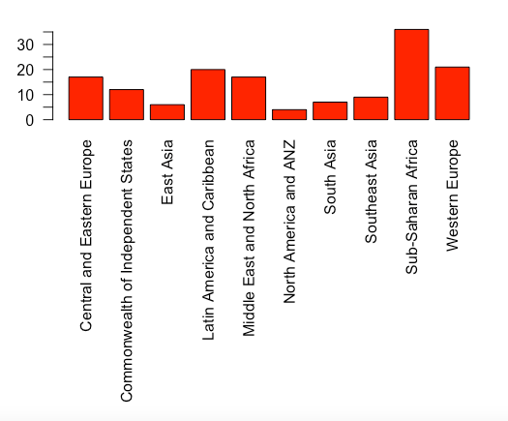
#3 Barplot for categorical data by country region

Slide 7
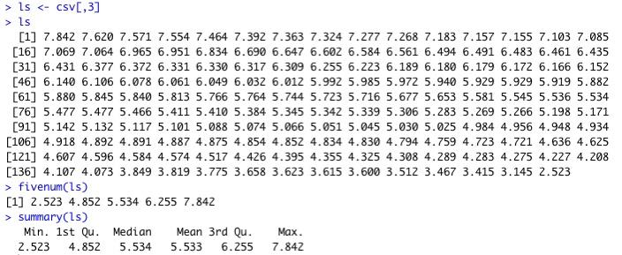
#4 Numerical data by ladder score

Slide 8
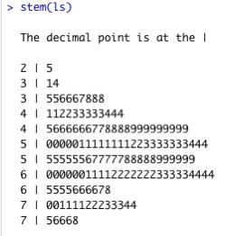
#5 Stem plot, Histogram and Boxplot for numerical data by ladder score

Slide 9
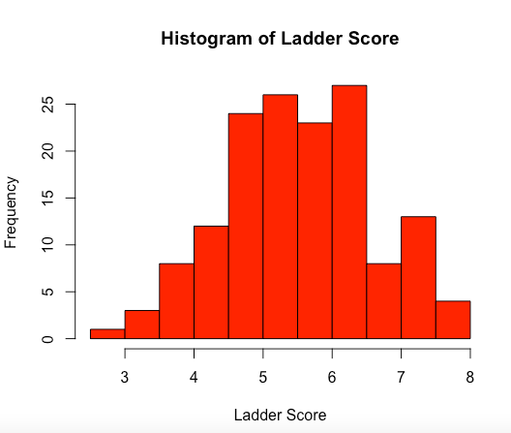

Slide 10
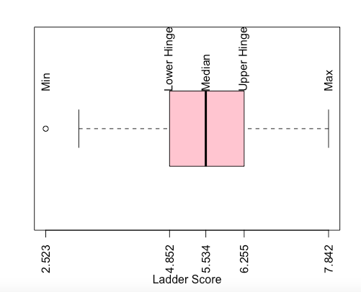

Slide 11
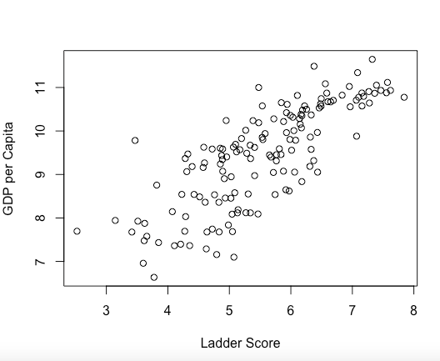
#6 Scatter plot for two-way table between Ladder score and GDP per capita

Slide 12
We can conclude that Ladder Score increases when GDP per capita increases. It’s a Proportional relationship

Slide 13
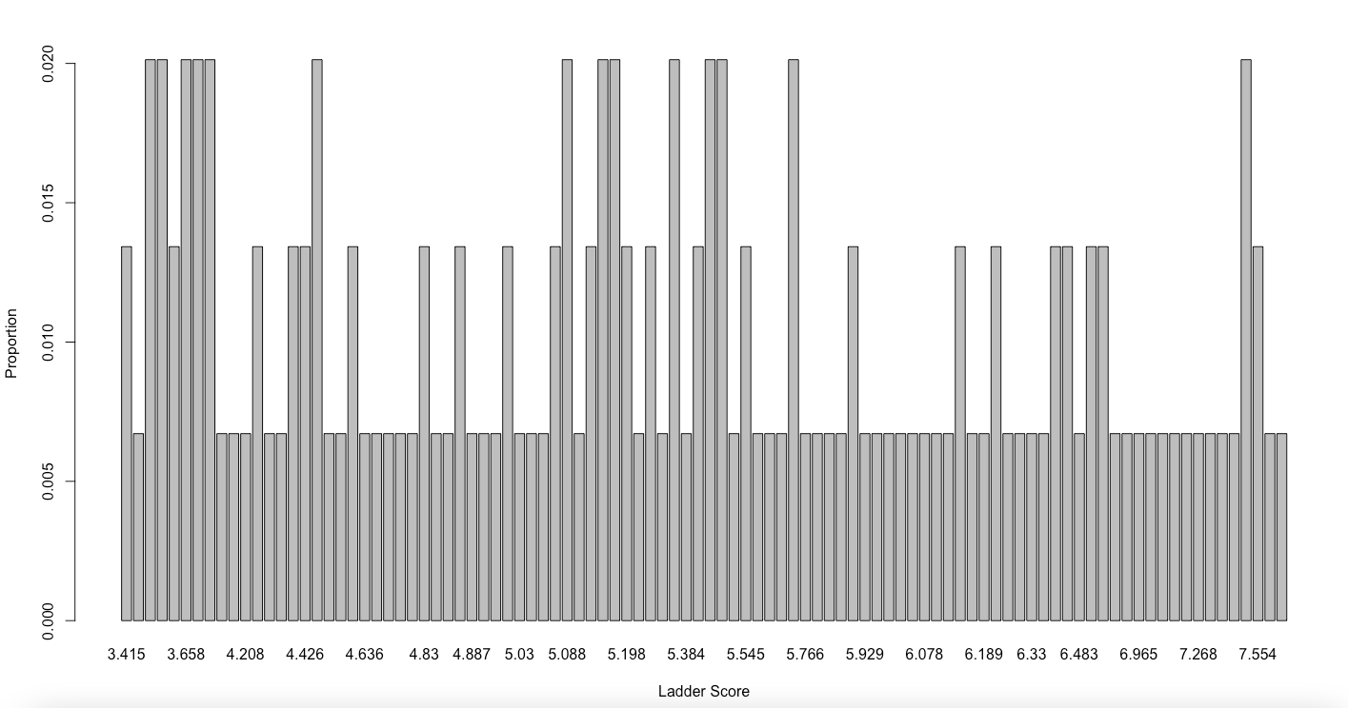
#7 Random samples(sample size = 5, 10, 20) and Central Limit Theorem for 149 Ladder Scores Using Discrete Uniform Distribution

Slide 14


Slide 15
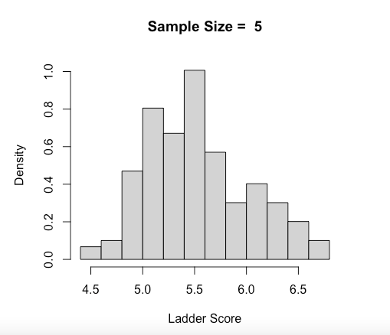
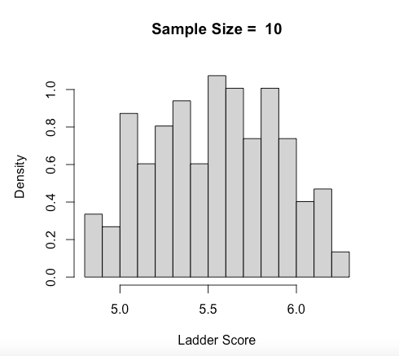
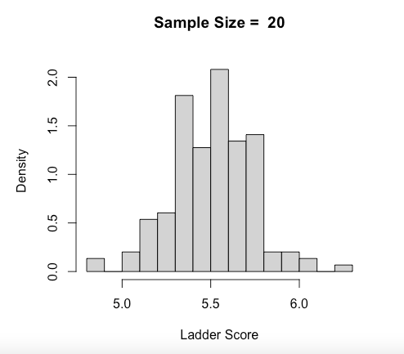


Slide 16
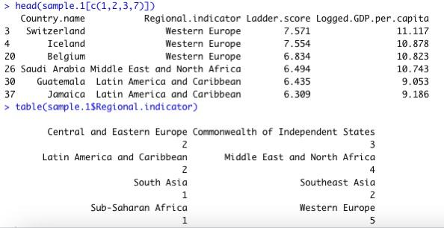
#8 Simple Random Sampling
(A simple sample random of size 20 is drawn from the ladder score without placement.)
(The data of the selected sample and the frequency of municipalities in each region are shown below.)

Slide 17
#9 Systematic Sampling
For a sample of size 20, the data is divided into 7 groups. From the first group, a random item is selected. The rows of the systematic sample are now computed by taking every 7th item. The selected sample is indexed from these rows. The frequency of municipalities in each region is shown below.

Slide 18
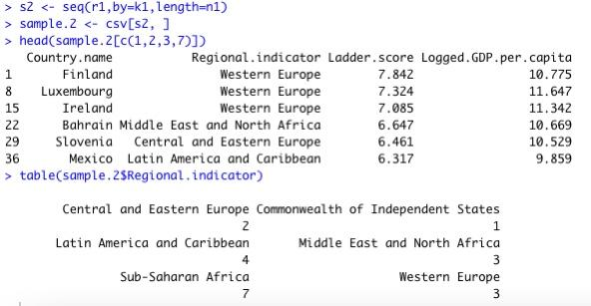

Slide 19
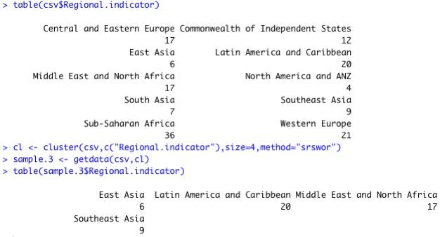
#10 Cluster Sampling
Cluster of size 4. Clustered by the region.

Slide 20
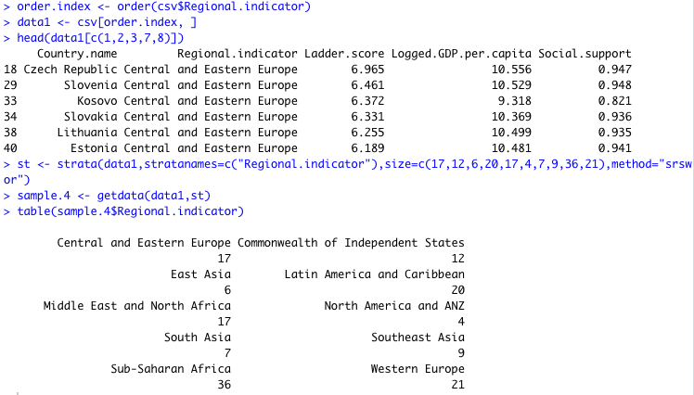
#11 Ordering Data
The dataset is ordered in the descending order by the first letter of the region. The sizes are each stratum of the seven regions is explicitly specified in the following.

